Slide 1
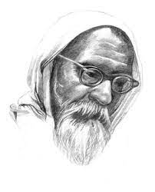
Vinoba Bhave: The Journey of a Social Reformer
Presented by: Shreerang Mhatre
Roll. No: 29
Batch: A2
Submitted to: Prof. Rekha Joshi Ma’am
Topic : PSRS Biography PPT

Slide 2
Early Life
Early LifeVinoba Bhave was born on September 11, 1895, in a small village called Gagode in Maharashtra, India. His real name was Vinayak Narahari Bhave, but he came to be known as Vinoba later in life. He was the eldest of five children and grew up in a traditional Brahmin family. His father was a prosperous landowner and his mother was a deeply religious woman who instilled in him a love for spirituality from an early age.
Despite his privileged upbringing, Vinoba was a sensitive child who was deeply affected by the poverty and inequality he saw around him. He was particularly disturbed by the plight of the untouchables, who were considered to be at the bottom of the Hindu caste system and were subjected to extreme discrimination and oppression. This early exposure to social injustice would shape his worldview and inspire him to dedicate his life to the service of humanity.

Slide 3
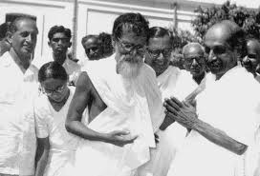
Spiritual Journey
Vinoba's spiritual journey began in earnest when he was just 12 years old. He became fascinated with the teachings of the Bhagavad Gita, one of the most important Hindu scriptures, and spent hours studying and meditating on its verses. This early interest in spirituality would eventually lead him to become a disciple of Mahatma Gandhi, who would have a profound influence on his life.
Under Gandhi's guidance, Vinoba became deeply involved in India's struggle for independence from British rule. He participated in numerous protests and campaigns, including the famous Salt Satyagraha, which saw thousands of Indians peacefully protesting against the British salt tax. Through his activism, Vinoba came to see that political freedom alone was not enough to bring about true liberation for the Indian people, and that social and economic justice were equally important goals.

Slide 4
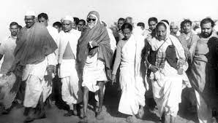
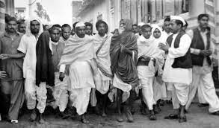
Bhoodan Movement
Vinoba's most significant contribution to Indian society was his creation of the Bhoodan (land gift) movement. In the 1950s, he embarked on a historic walk across India, during which he asked wealthy landowners to voluntarily donate a portion of their land to the poor and landless. His message was simple: land is a gift of God, and those who have been blessed with it have a duty to share it with those in need.
The Bhoodan movement quickly gained momentum and became a powerful force for social change in India. Over the years, millions of acres of land were donated, and thousands of families were able to establish their own farms and become self-sufficient. Vinoba's vision of a more equitable and just society had taken root, and his legacy continues to inspire generations of social activists around the world.

Slide 5
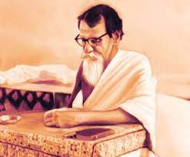
Philosophy of Nonviolence
Vinoba's philosophy of nonviolence was deeply influenced by his spiritual beliefs and his close association with Mahatma Gandhi. He believed that violence only begets more violence, and that true change could only come about through peaceful means. He practiced what he preached, and his commitment to nonviolence was evident in all aspects of his life.
Vinoba's advocacy of nonviolence was not limited to India. He was a vocal opponent of nuclear weapons and war, and he spoke out against the Vietnam War and other conflicts around the world. His message of peace and compassion continues to resonate with people of all faiths and backgrounds, and his legacy as a champion of nonviolence is one of his most enduring contributions to humanity.

Slide 6
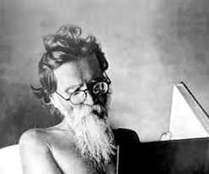
Legacy and Impact
Vinoba Bhave passed away on November 15, 1982, at the age of 87. However, his legacy continues to inspire people around the world to this day. His vision of a more just and equitable society, based on the principles of nonviolence and compassion, remains as relevant as ever.
Vinoba's impact on Indian society cannot be overstated. His Bhoodan movement empowered millions of poor and landless farmers, and his philosophy of nonviolence helped to shape India's national identity. He was a true visionary who dedicated his life to the service of humanity, and his example continues to inspire generations of social activists and spiritual seekers around the world.

Slide 7
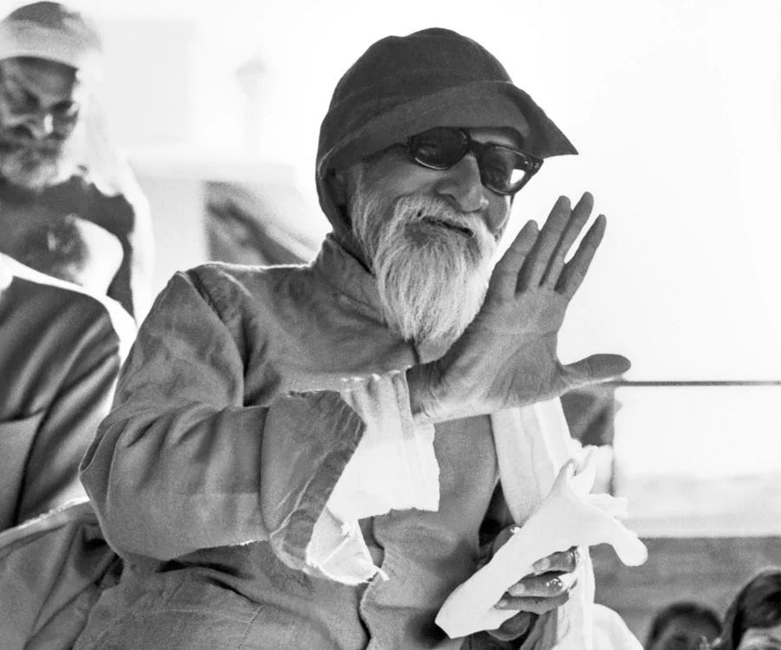
Conclusion
Vinoba Bhave was a remarkable individual who lived a life of service and devotion. His commitment to social justice, nonviolence, and spirituality inspired millions of people around the world, and his legacy continues to be felt today. Through his example, we can learn the power of compassion, the importance of giving back to our communities, and the transformative potential of nonviolence. Vinoba Bhave's life and work remind us that we all have the capacity to make a difference in the world, and that even the smallest actions can have a profound impact on those around us.
In conclusion, Vinoba Bhave's biography is a testament to the power of human spirit and the transformative potential of social activism. His life and work offer valuable lessons for anyone seeking to make a positive impact on the world, and his legacy will continue to inspire generations to come.

Slide 8
References:
https://en.wikipedia.org/wiki/Vinoba_Bhave
https://www.britannica.com/biography/Vinoba-Bhave
https://www.vbu.ac.in/
https://www.drishtiias.com/daily-updates/daily-news-analysis/ncharya-vinoba-bhave
https://www.vinobabhave.org/
https://www.google.com/search?q=vinoba+bhave&rlz=1C1CHBF_enIN1044IN1044&sxsrf=APwXEdf9ipPNCZwfoTgQ5FM6nJOmWt0s8g:1682952740075&source=lnms&tbm=isch&sa=X&ved=2ahUKEwjVsPvBr9T-AhXd6jgGHRptAPEQ_AUoAXoECAEQAw

Slide 9
Thankyou

